Slide 1
LAB5:
OpenCV and Depth Sensing
3/30
Wolf Chen

Slide 2
Outline
When Robots meet Sensors…
What kinds of the informations does robot need?
Keep the eyes on the robots
What does the robots see…
What do we want the robots see...
How to debug?

Slide 3
Why Robots Need Sensors?

Slide 4
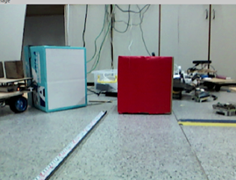
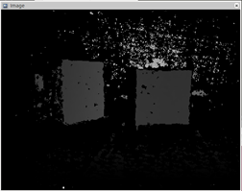
Eyes
Color Information
RGB Image
Depth Information
Depth Image
When Color meets Depth…

Slide 5
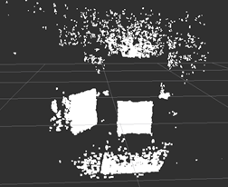
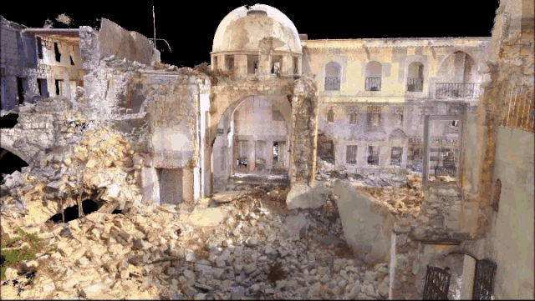
Point Cloud
Contains R, G, B, X, Y, Z, strength…...

Slide 6
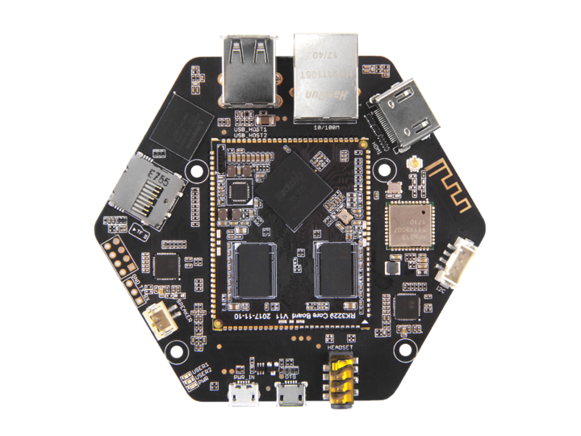
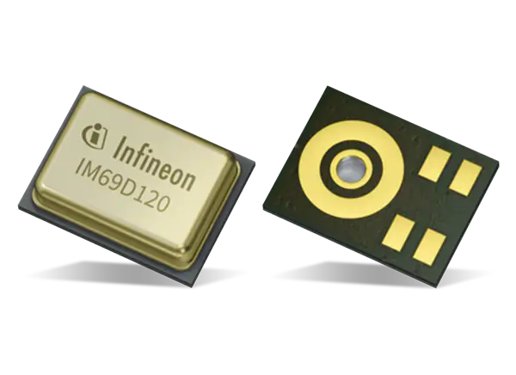
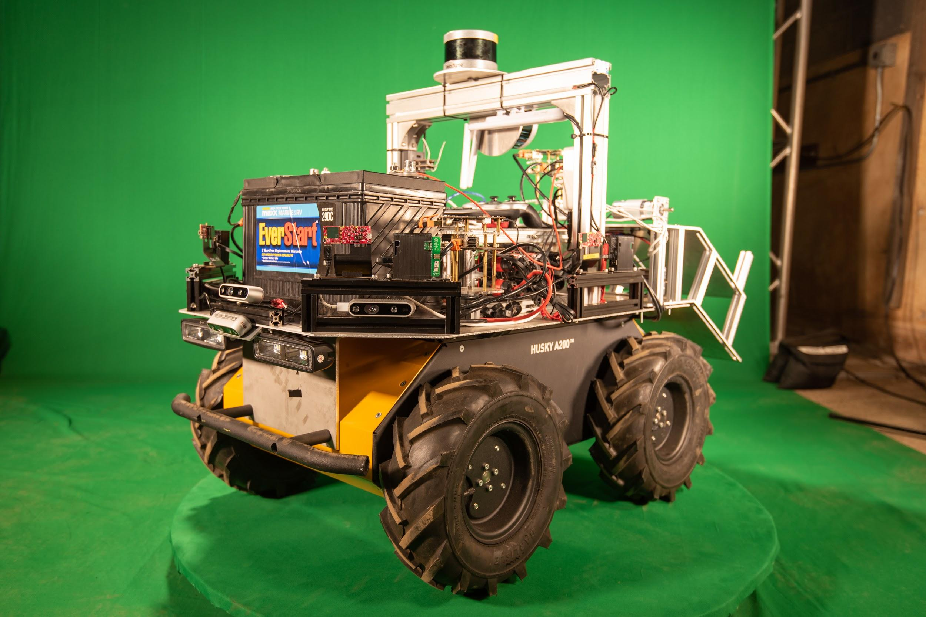
Ears
Microphone
Single Microphone
Microphone Array
Our UGV in Darpa SubT Challenge Urban Circuit

Slide 7
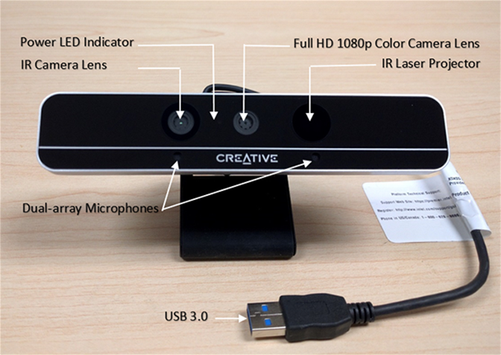
RGBD Cameras

Slide 8
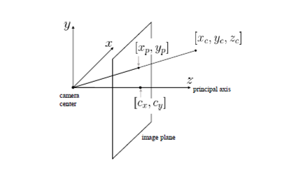
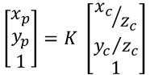
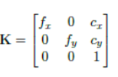
X? Y? Z?
cx, cy : image center (pixel)
fx, fy : focal length
xp, yp: index of the depth image
xc, yc, zc : camera coordinate
x, y, z: real world coordinate
Pin hole projection
Intrinsic matrix

Slide 9
What does the Robot See?

Slide 10
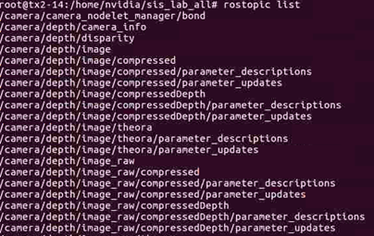
Informations in ROS
Camera info: Camera parameters
RGB image
Depth image
Raw image: uint16 type
Image: float type
Rectified image: image which is transformed to the same plane as RGB image.
Registered image: image which is registered with RGB image
rostopic list

Slide 11
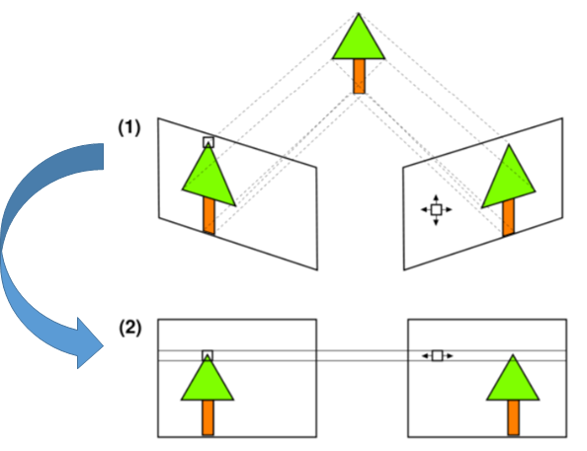
Image Rectification

Slide 12
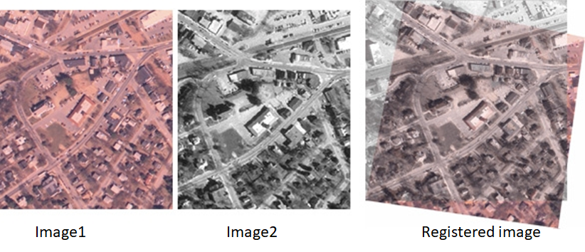
Image Registration

Slide 13
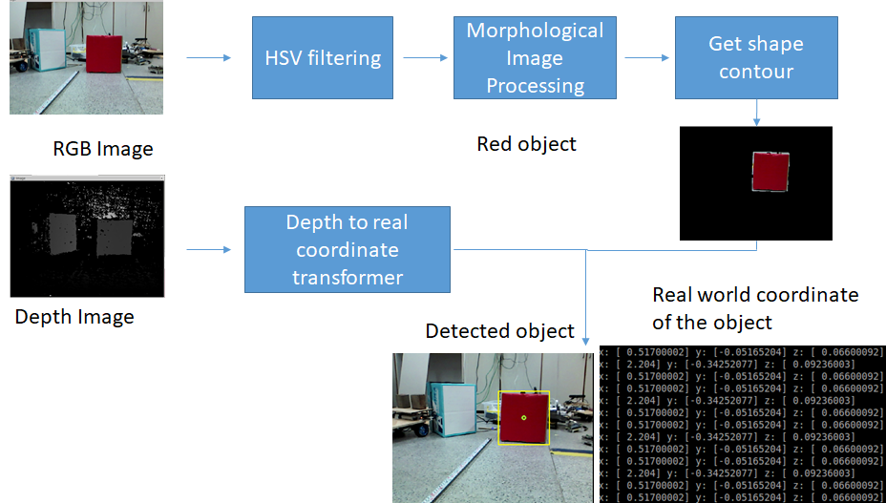
Lab5

Slide 14
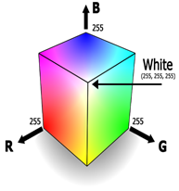

HSV Filtering
Example: cv2.inRange(hsv, lower_green, upper_green)
RGB Color Space
HSV Color Space
H: Hue
S: Saturation
V: Value

Slide 15
Morphological Image Processing
Scenario: Remove imperfections or noise from the filtered binary image.
Erosion: cv2.erode(mask, kernel, iterations=1)
Dilation: cv2.dilate(mask, kernel, iterations=1)
Pipeline

Slide 16
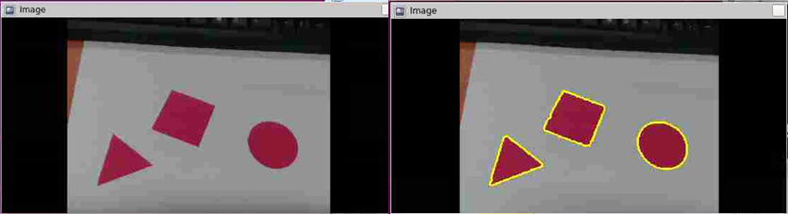
Find Contour
To get all boundary points of all objects
cv2.findContours(binary image, mode, method)

Slide 17
How to debug
Find “x”
Google it
Ask your teammates
Ask TAs

